Slide 1
SPRING BOOT

Slide 2
SPRING FRAMEWORK
Advantages:
A lightweight alternative to J2EE
POJO+DI+AOP instead of EJB (light component code)
annotation-based component-scanning reduced use of XML configuration (Spring 2.5)
Java-based configuration as a type-safe and refactorable option to XML (Spring 3.0)

Slide 3
SPRING FRAMEWORK
Problems:
Certain features like transaction management and Spring MVC still require explicit configuration
Enabling third-party library features such as Thymeleaf-based web views require explicit configuration
Configuring servlets and filters (such as Spring’s DispatcherServlet) required explicit configuration in web.xml or in a servlet initializer
project dependency management hell (library versions etc)

Slide 4
SPRING BOOT
Provides:
Automatic configuration for common web app functionalities (JPA, security, Spring MVC etc)
Starter dependencies (select tehnology stack and libraries are selected automatically)
The command-line interface (write just app code , no traditional project build needed)
The Actuator (dashboard to inspect inside running app) (HTTP request trace, conf. properties, resource metrics, threads state)
What Spring Boot isn’t : no app server, it embeds a servlet container, does not generate code

Slide 5

SPRING BOOT CLI
an easy way to get started with Spring Boot and to prototype simple applications
leverages starter dependencies and auto-configuration to let you focus on writing code

Slide 6
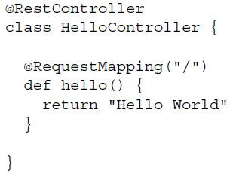
SPRING BOOT CLI – HELLO WORD
HelloController.groovy
CLI cmd line:
spring run HelloController.groovy
http://localhost:8080/

Slide 7
SPRING INITIALIZR
a web application that can generate a Spring Boot project structure for you
Spring Initializr can be used in several ways:
Through a web-based interface (http://start.spring.io)
Via Spring Tool Suite (Spring Boot IDE based on Eclipse)
Via IntelliJ IDEA
Using the Spring Boot CLI:
  spring init -dweb,jpa,security --build gradle -p jar –x
  list parameter: spring init -l

Slide 8
FIRST SPRING BOOT APPLICATION
we’re going to use Spring MVC to handle web requests
Thymeleaf to define web views
Spring Data JPA to persist the reading selections to a database. For now, that database will be an embedded H2 database.
we’ll write the application code in Java for now. (also Groovy is an option)
we’ll use Gradle as our build tool of choice.
spring init -dweb,data-jpa,h2,thymeleaf --build gradle readinglist

Slide 9
FIRST SPRING BOOT APPLICATION
ReadingListApplication class serves two purposes in a Spring Boot application:
configuration and bootstrapping (has a main() method to run it directly)
annotated with @SpringBootApplication (@Configuration + @ComponentScan +@EnableAutoConfiguration)
@Configuration - Designates a class as a configuration class using Spring’s Java-based configuration
@ComponentScan - Enables component-scanning so that the web controller classes and other components you write will be automatically discovered and registered as beans in the Spring application context
gradle bootRun (build and run it)

Slide 10
TESTING SPRING BOOT APPLICATIONS
ReadingListApplicationTests annotated with:
@RunWith(SpringJUnit4ClassRunner.class)
@SpringApplicationConfiguration(classes = ReadingListApplication.class) (Load context via Spring Boot)
@WebAppConfiguration

Slide 11
USING STARTER DEPENDENCIES
compile("org.springframework:spring-web:4.1.6.RELEASE")
compile("org.thymeleaf:thymeleaf-spring4:2.1.4.RELEASE")
compile("org.springframework.data:spring-data-jpa:1.8.0.RELEASE")
compile("org.hibernate:hibernate-entitymanager:jar:4.3.8.Final")
compile("com.h2database:h2:1.4.187")

Slide 12
CUSTOMIZING STARTER DEPENDENCIES
If you’re using Gradle, you can exclude transitive dependencies like this:
compile("org.springframework.boot:spring-boot-starter-web") {
exclude group: 'com.fasterxml.jackson.core‘
}
Then specify newer version:
compile("com.fasterxml.jackson.core:jackson-databind:2.4.3")

Slide 13
USING AUTOMATIC CONFIGURATION
There are nearly 200 such decisions that Spring Boot makes with regard to autoconfiguration every time an application starts up, covering such areas as: security, integration, persistence, and web development. Examples:
Is Spring’s JdbcTemplate available on the classpath? If so and if there is a Data-Source bean, then auto-configure a JdbcTemplate bean.
Is Thymeleaf on the classpath? If so, then configure a Thymeleaf template resolver, view resolver, and template engine.
Is Spring Security on the classpath? If so, then configure a very basic web security setup.
in your application only business code is needed, no boiler plate configuration

Slide 14
SPRING 4.0. CONDITIONAL CONFIGURATION
Spring Boot auto-configuration is built internally upon Spring 4 conditional configuration
allows for configuration to be available in an application, but to be ignored unless certain conditions are met
implement the Condition interface and override its matches() method the use it in annotation @Conditional(JdbcTemplateCondition.class to specify when a bean should be created
@ConditionalOnBean …the specified bean has been configured
@ConditionalOnMissingBean …the specified bean has not already been configured
@ConditionalOnClass …the specified class is available on the classpath
@ConditionalOnMissingClass …the specified class is not available on the classpath

Slide 15
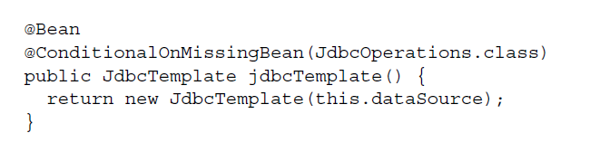
AUTO-CONFIGURATION DECISIONS
to configure a
JdbcTemplate bean only if needed
H2 is on the classpath -> H2 db is created
Spring Data JPA is on the classpath -> automatically create repository implementations from repository interfaces.
Tomcat is on the classpath (transitively referred to by the web starter
dependency) -> an embedded Tomcat container will be started to listen on port 8080

Slide 16
CUSTOMIZING CONFIGURATION
Overriding auto-configured beans
Configuring with external properties
Customizing error pages

Slide 17
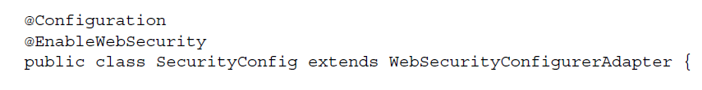
OVERRIDING SPRING AUTO-CONFIGURED BEANS
- all you need to do to override Spring Boot auto-configuration is to write
explicit configuration. Spring Boot will see your configuration, step back, and let your
configuration take precedence.

Slide 18
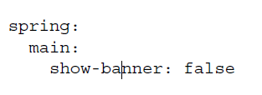
CONFIGURING WITH EXTERNAL PROPERTIES
specify the property as a command-line parameter:
$ java -jar readinglist-0.0.1-SNAPSHOT.jar --spring.main.show-banner=false
create a file named application.properties which contains
spring.main.show-banner=false
create a YAML file named application.yml which contains:

Slide 19
CONFIGURING WITH EXTERNAL PROPERTIES
Spring Boot will draw properties from several property sources, including the following:
Command-line arguments / Operating system environment variables
JNDI attributes from java:comp/env, or JVM system properties
Randomly generated values for properties prefixed with random.* (referenced when setting other properties, such as `${random.long})
An application.properties or application.yml file outside of the application or packaged inside of the
Application
Property sources specified by @PropertySource
Default properties

Slide 20
CONFIGURING WITH EXTERNAL PROPERTIES
As for the application.properties and application.yml files, they can reside in any of four locations:
Externally, in a /config subdirectory of the directory from which the application is run
Externally, in the directory from which the application is run
Internally, in a package named “config”
Internally, at the root of the classpath

Slide 21
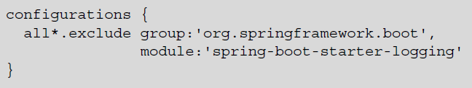
FINE-TUNING AUTO-CONFIGURATION
Disabling thymeleaf cache: spring.thymeleaf.cache=false
Configuring the embedded server: server.port=8000
Swapping out Logback for another logging implementation:

Slide 22
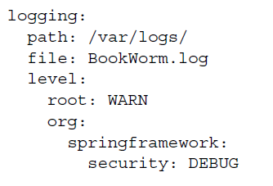
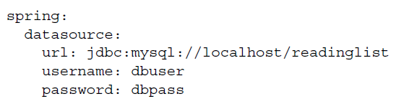
FINE-TUNING AUTO-CONFIGURATION
Confgure logging:
Switch datasource from H2 to MySQL:

Slide 23
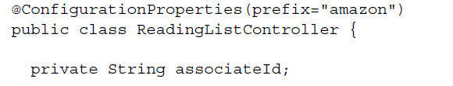
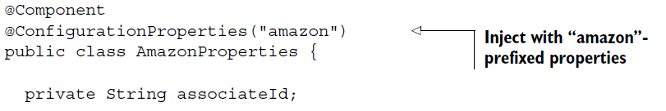
EXTERNALLY CONFIGURING APPLICATION BEANS
amazon.associateId=habuma-20
Or keep all properties in a dedicated bean:

Slide 24
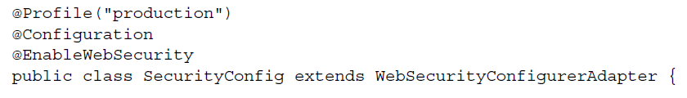
CONFIGURING WITH PROFILES
PROFILE-SPECIFIC PROPERTIES FILES : “application-{profile}.properties”
MULTI-PROFILE YAML FILES (you also have the option of expressing configuration properties for all profiles in a single application.yml file)
Customize security configuration only for production:
spring.profiles.active=production

Slide 25
TESTING WITH SPRING BOOT
Integration testing
Testing apps in a server
Spring Boot’s test utilities

Slide 26
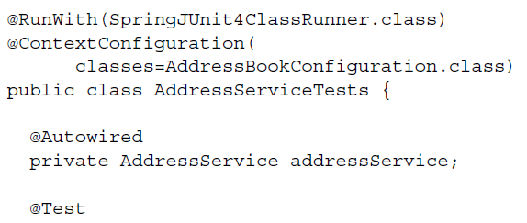

AUTO-CONFIGURATION FOR INTEGRATION TESTING WITH SPRING
@RunWith is given SpringJUnit4ClassRunner.class to enable Spring
integration testing, allows autowiring
@ContextConfiguration - load the Spring application context given
the specification defined in AddressBookConfiguration

Slide 27
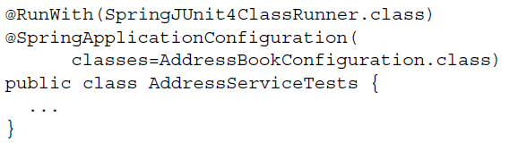
AUTO-CONFIGURATION FOR INTEGRATION TESTING WITH SPRING BOOT
@SpringApplicationConfiguration
replaces @ContextConfiguration when writing tests for Spring Boot applications
- unlike @ContextConfiguration, @SpringApplicationConfiguration
loads the Spring application context using SpringApplication the same way
and with the same treatment it would get if it was being loaded in a production application.
This includes the loading of external properties and Spring Boot logging.

Slide 28
TESTING WEB APPLICATIONS
To properly test a web application, you need a way to throw actual HTTP requests at
it and assert that it processes those requests correctly. Fortunately, there are two options
available to Spring Boot application developers that make those kinds of tests possible:
Spring Mock MVC—Enables controllers to be tested in a mocked approximation
of a servlet container without actually starting an application server
Web integration tests—Actually starts the application in an embedded servlet container
(such as Tomcat or Jetty), enabling tests that exercise the application in a
real application server

Slide 29
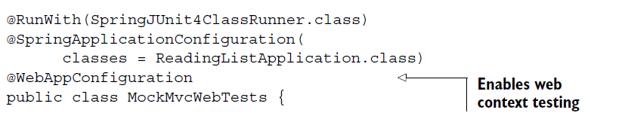
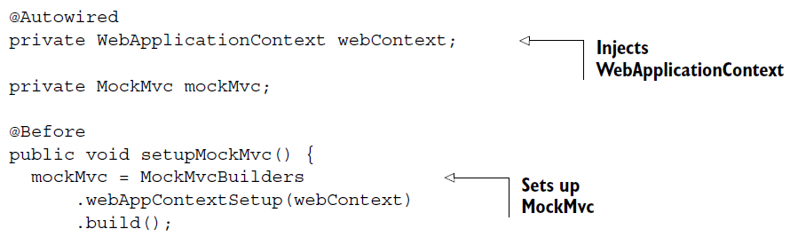
MOCKING SPRING MVC

Slide 30
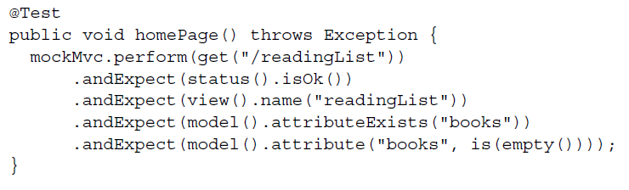
MOCKING SPRING MVC
@WebAppConfiguration - declares that the application context created by SpringJUnit4ClassRunner should be a WebApplicationContext (as opposed to a basic non-web ApplicationContext).
The setupMockMvc() method is annotated with JUnit’s @Before, indicating that it
should be executed before any test methods. It passes the injected WebApplication-
Context into the webAppContextSetup() method and then calls build() to produce a
MockMvc instance, which is assigned to an instance variable for test methods to use.

Slide 31
TESTING WEB SECURITY
testCompile("org.springframework.security:spring-security-test")
Spring Security offers two annotations for authenticated request:
@WithMockUser—Loads the security context with a UserDetails using the given
username, password, and authorization
@WithUserDetails—Loads the security context by looking up a UserDetails
object for the given username

Slide 32
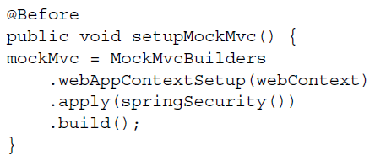
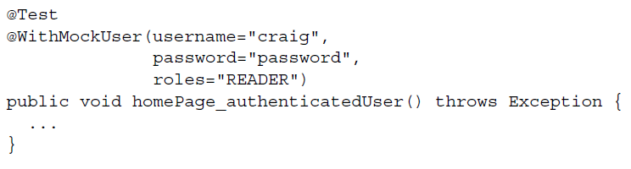
TESTING WEB SECURITY

Slide 33
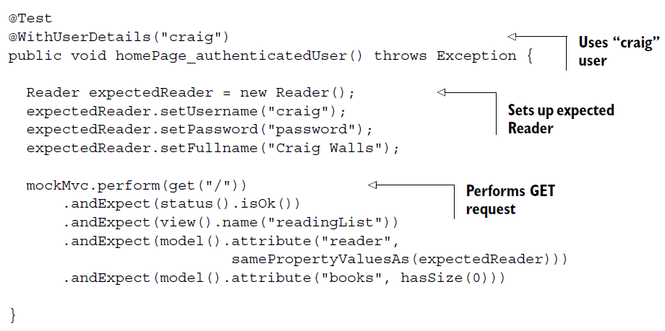
TESTING WEB SECURITY

Slide 34
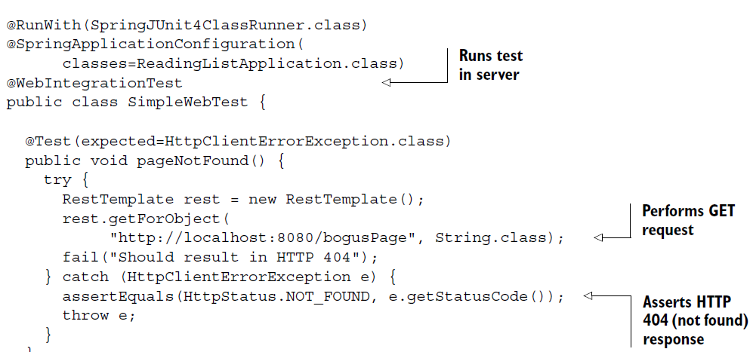
TESTING A RUNNING APPLICATION
@WebIntegrationTest - Spring Boot will not only create an application context for your test, but also to start an embedded servlet container.

Slide 35
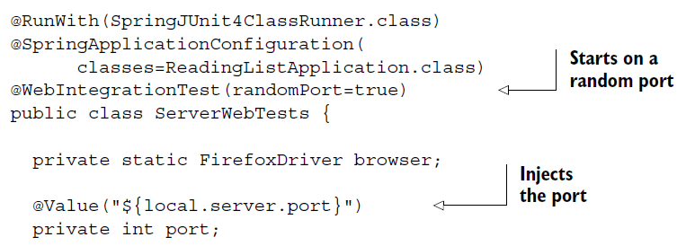
TESTING HTML PAGES WITH SELENIUM
RestTemplate is fine for simple requests and it’s perfect for testing REST endpoints
testCompile("org.seleniumhq.selenium:selenium-java:2.45.0")

Slide 36
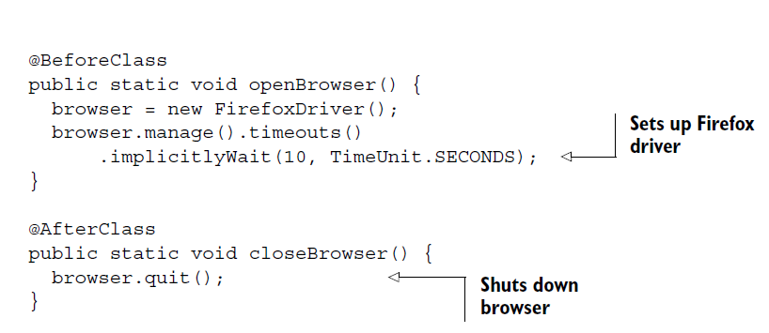
TESTING HTML PAGES WITH SELENIUM

Slide 37
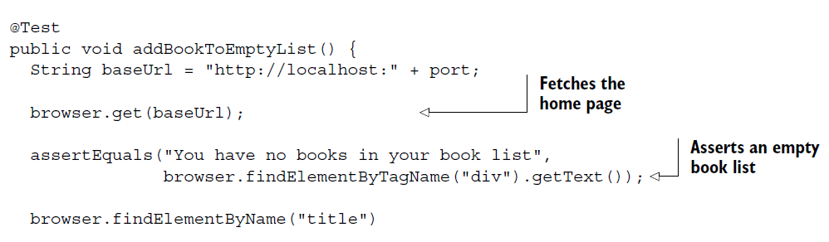
TESTING HTML PAGES WITH SELENIUM

Slide 38
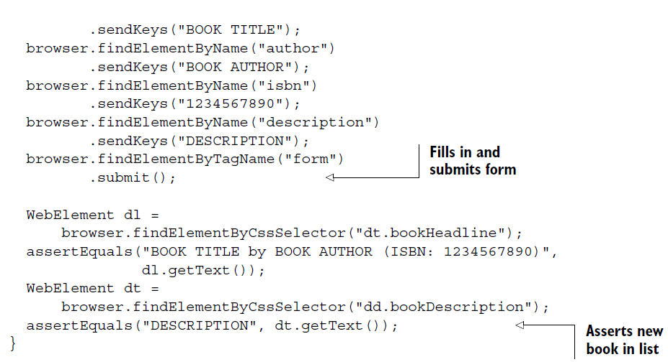
TESTING HTML PAGES WITH SELENIUM

Slide 39
TAKING A PEEK INSIDE WITH THE ACTUATOR
Actuator web endpoints
To enable as REST service: compile 'org.springframework.boot:spring-boot-starter-actuator‘
Adjusting the Actuator
Shelling into a running application
As remote shell in app: compile("org.springframework.boot:spring-boot-starter-remote-shell")
Securing the Actuator

Slide 40
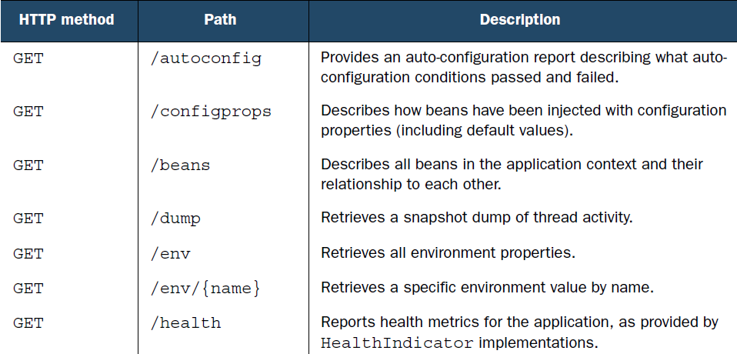
EXPLORING THE ACTUATOR’S ENDPOINTS

Slide 41
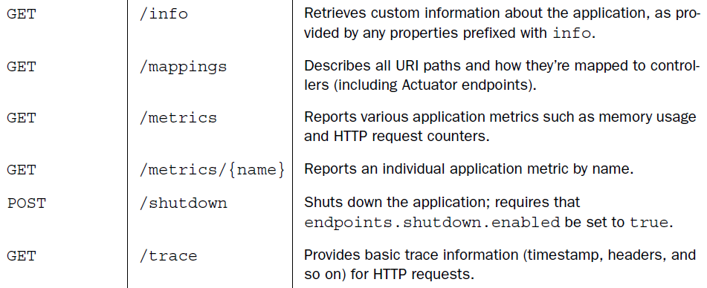
EXPLORING THE ACTUATOR’S ENDPOINTS

Slide 42
CUSTOMIZING THE ACTUATOR
As it turns out, the Actuator can be customized in several ways, including the following:
Renaming endpoints
Enabling and disabling endpoints
Defining custom metrics and gauges
Creating a custom repository for storing trace data
Plugging in custom health indicators

Slide 43
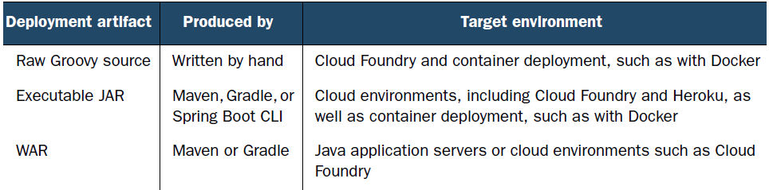
DEPLOYING SPRING BOOT APPLICATIONS
Deploying WAR files
Database migration
Deploying to the cloud

Slide 44

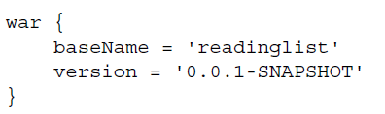
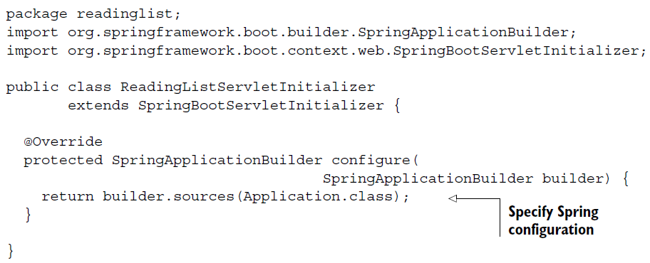
DEPLOYING TO AN APPLICATION SERVER
Building a WAR file:
Instead of web.xml file or servlet initializer use this
in order to configure Spring’s DispatcherServlet and register any beans of type Filter, Servlet:

Slide 45
DEPLOYING ON TOMCAT
$ gradle build -> will produce a file named readinglist-0.0.1-SNAPSHOT.war in build/libs
copy the WAR file into Tomcat’s webapps directory
http://server:_port_/readinglist-0.0.1-SNAPSHOT
$ java -jar readinglist-0.0.1-SNAPSHOT.war (also possible because we have main())

Slide 46
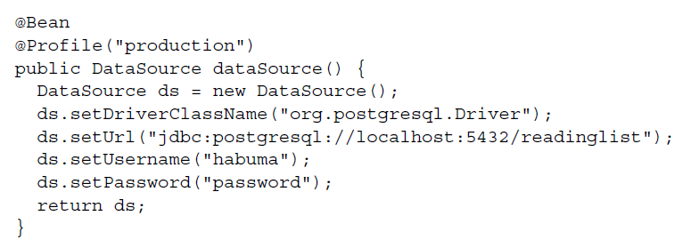
SWITCH DATESOURCE TO A PRODUCTION DB
Replace the auto-configured DataSource bean for H2 db with Postgress db
org.apache.tomcat.jdbc.pool.DataSource:

Slide 47
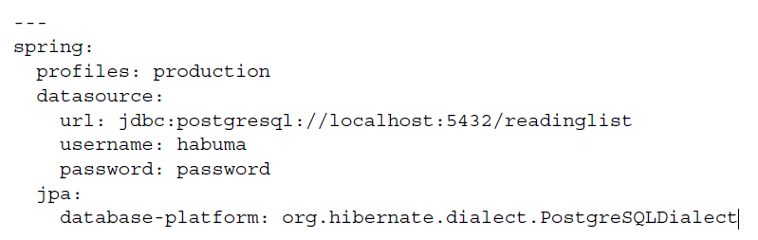
...OR CONFIGURE PRODUCTION PROFILE
...and activate PRODUCTION PROFILE:
$ export SPRING_PROFILES_ACTIVE=production

Slide 48
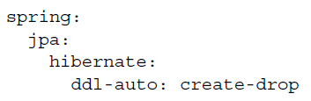
CONFIGURE SCHEMA CREATION
This configuration is default for H2 but we need to explicit set it for Postgres: the schema should be created when Hibernate’s SessionFactory is created and dropped when it is closed
... or for production Spring Boot includes auto-configuration support for two popular database migration libraries:
Flyway (http://flywaydb.org)
Liquibase (www.liquibase.org)

Slide 49
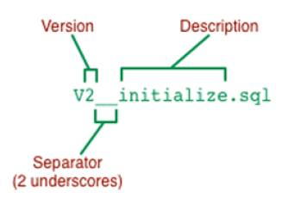
DEFINING DATABASE MIGRATION WITH FLYWAY
compile("org.flywaydb:flyway-core")
Set spring.jpa.hibernate.ddl-auto to none.
Put in main/resources/db/migration SQL schema creation script with this signature:
Flyway Disadvantage:
- with SQL, you run the risk of defining a migration script that works with
one database platform but not another

Slide 50
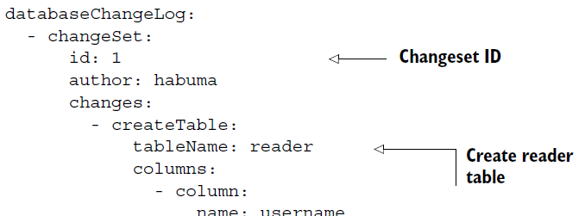
DEFINING DATABASE MIGRATION WITH LIQUIBASE
compile("org.liquibase:liquibase-core")
Set property for liquibase change-log to xml / yaml / json / SQL
Liquibase changesets are all collected in the same file (unlike Flyway)

Slide 51
DEPLOYING TO CLOUD FOUNDRY
Cloud Foundry is a PaaS (platform as a service) platform from Pivotal, the same company that sponsors the Spring Framework
it is both open source and has several commercial distributions
We deploy on PWS : http://run.pivotal.io (60-day free trial)
download and install the cf command-line tool from https://console.run.pivotal.io/tools
Login : $ cf login -a https://api.run.pivotal.io
$ cf push sbia-readinglist -p build/libs/readinglist.war (first param = app subdomain)

Slide 52
DEPLOYING TO CLOUD FOUNDRY
full URL for the application will be http://sbia-readinglist.cfapps.io
To generate unique subdomain (add 2 random woirds):
cf push sbia-readinglist -p build/libs/readinglist.war --random-route
The resulting subdomain: sbia-readinglist-gastroenterological-stethoscope
Data does not survive app restart because we using H2 (login, use app URL, use command : cf restart) (check db by requesting the Actuator’s /health endpoint)

Slide 53
DEPLOY POSTGRESQL IN CLOUD FOUNDRY
List available plans:
$ cf marketplace -s elephantsql
Create postgres db service with the free “turtle” plan:
$ cf create-service elephantsql turtle readinglistdb
Bind service to our app:
$ cf bind-service sbia-readinglist readinglistdb
Replace Datasource & Redeploy app:
$ cf restage sbia-readinglist

Slide 54
SPRING BOOT DEVELOPER TOOLS
Spring Boot 1.3 introduced a new set of developer tools that make it even easier to
work with Spring Boot at development time. Among its many capabilities are
Automatic restart—Restarts a running application when files are changed in the classpath
LiveReload support—Changes to resources trigger a browser refresh automatically
Remote development—Supports automatic restart and LiveReload when deployed remotely
Development property defaults—Provides sensible development defaults for some configuration properties
To enable it, use: compile "org.springframework.boot:spring-boot-devtools"

Slide 55
THE END

